Slide 1
Science Lab Safety Foldable

Slide 2
Science Lab Safety
Foldable
Protective Wear
Plants and Animals
Using Equipment Safely
General Safety
In Case of Accidents

Slide 3
Protective Wear
Wear safety goggles when directed to do so
Wear an apron to protect clothing
Use protective gloves when necessary
Tie back loose hair and clothing

Slide 4
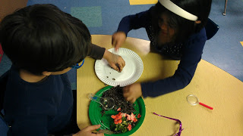
Plants and Animals
Only handle plants and animals if instructed by the teacher
Do not mistreat animals
Wash hands after handling plants and animals

Slide 5
Using Equipment
Make sure you know how to use equipment before starting an activity.
Report any broken equipment to the teacher.
Do not use any electrical equipment unless properly
supervised.
Put all equipment away properly when done using it

Slide 6
General Safety
Read all directions.
Ask for help if you don't understand something
Keep your work area clean and neat
Clean up spills
No playing around the lab
No eating and drinking in the lab
Use sharp instruments with care and supervision

Slide 7
In Case of Accidents
Report accidents to the teacher or other adult supervisor
Get help immediately

Slide 8
What’s Wrong With This Picture?

Slide 9
What’s Wrong With This Picture?

Slide 10
What’s Wrong With This Picture?

Slide 11
What’s Wrong With These Statements?
Hal says that his teacher is solely responsible for preventing laboratory accidents.
Keshia started the lab activity before reading it through completely.
Ricardo decided to do a lab activity that he read about in a library book before the teacher came into the classroom.
Stephanie says that the safety goggles mess up her hair and give her raccoon eyes. She refuses to wear them.
Barbie and Ken accidentally break a beaker full of some chemical. Instead of risking getting in trouble they quickly clean up the mess with paper towel and throw it in the garbage.

Slide 12
