Slide 1
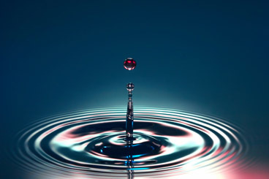
Properties
Of
Water

Slide 2
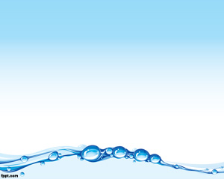
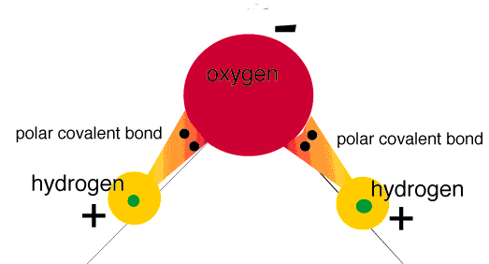
Polarity
Substances can either be POLAR or NONPOLAR
Water is Polar
That means electrons are not shared equally

Slide 3
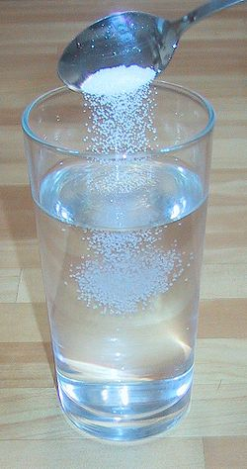
Universal Solvent
Because water is polar it can dissolve many things like sugar, salt, and even burned on macaroni in a pot
That is why it is called the universal solvent

Slide 4
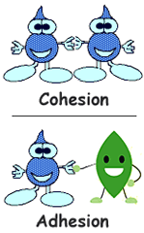
Cohesion vs Adhesion
This is the stickiness of water
Cohesion is water sticking with other water
Adhesion is water sticking to other things

Slide 5
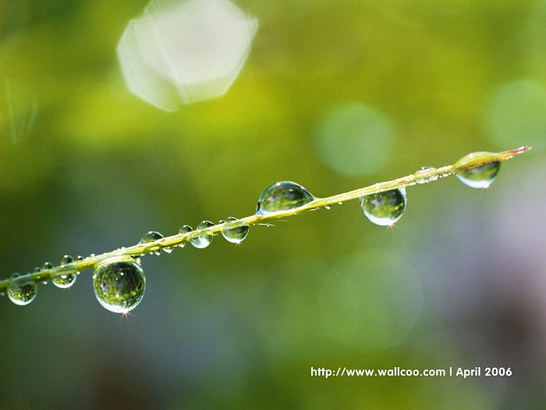
Adhesion

Slide 6
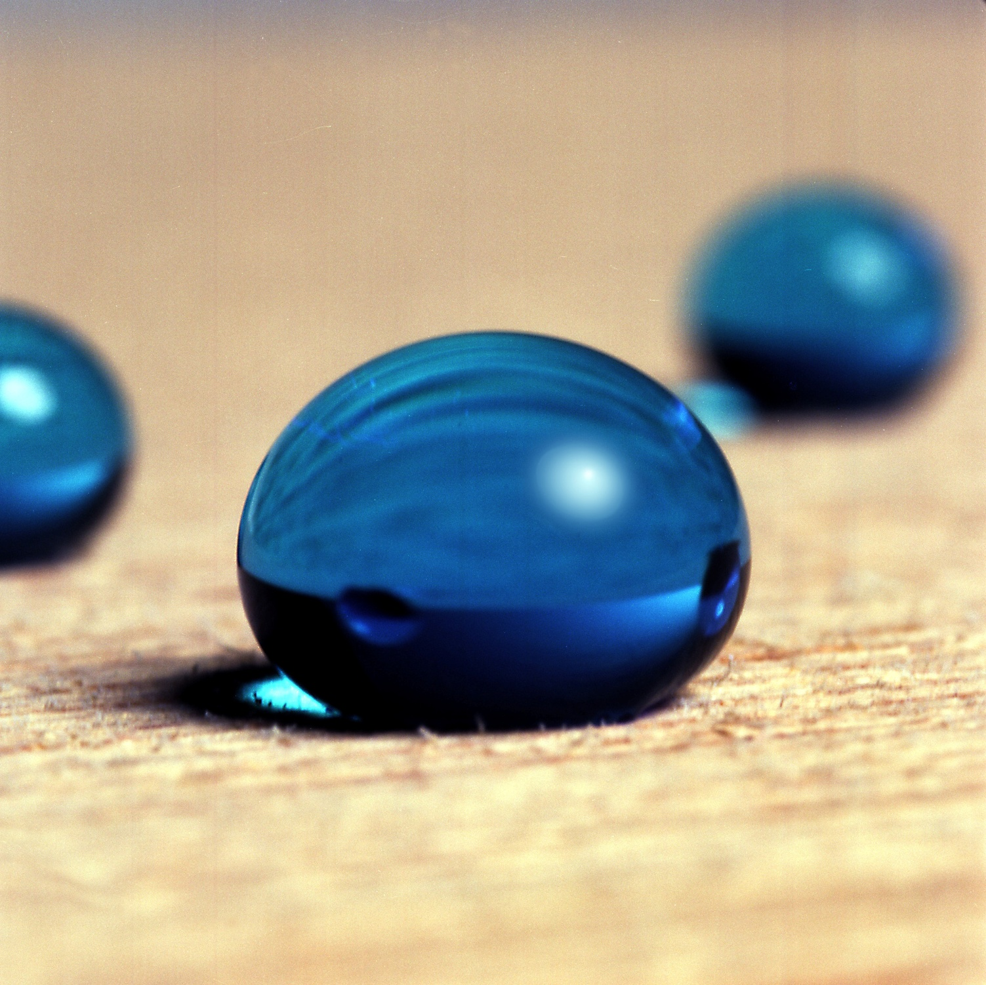
Cohesion

Slide 7
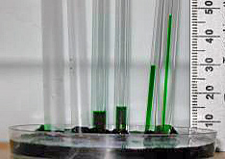
Capillary Action
Because of adhesion and cohesion, water has a unique property called capillary action
It is the movement of water through porous spaces

Slide 8
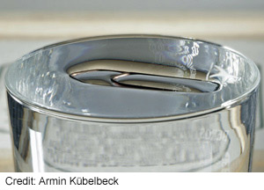
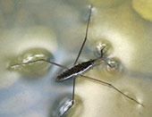
Surface Tension
Has to do with cohesion
Property of water that allows it to resist external force

Slide 9
Polarity Definition: Importance to Humans and Animals: | Universal Solvent Definition: Importance to Humans and Animals:
Adhesion Definition: How we come in contact with it (3 ways): Picture | Cohesion Definition: How we come in contact with it (3 ways): Picture
Capillary Action Definition: How we come in contact with it (3 ways): Picture | Surface Tension Definition: How we come in contact with it (3 ways): Picture

