Slide 1
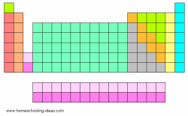
T
H
E
P
E
R
I
O
D
I
C
T
A
B
L
E
O
F
E
L
E
M
E
N
T
S

Slide 2
History of the Periodic Table
Early ancient times in AD and BC elements were discovered such as Copper, Gold, and Silver
1669- Discovery of the element-Phosphorus
German merchant and amateur alchemist Hennig Brand attempted to created a Philosopher’s Stone; an object that supposedly could turn metals into pure gold. He heated residues from boiled urine, and a liquid dropped out and burst into flames. This was the first discovery of phosphorus.

Slide 3
History of the Periodic Table
1809- At least 47 elements are discovered
1863- A scientist divides the 56 elements into 11 groups based on characteristics
Dmitri Mendeleev started the development of the periodic table based on the elements’ atomic mass

Slide 4
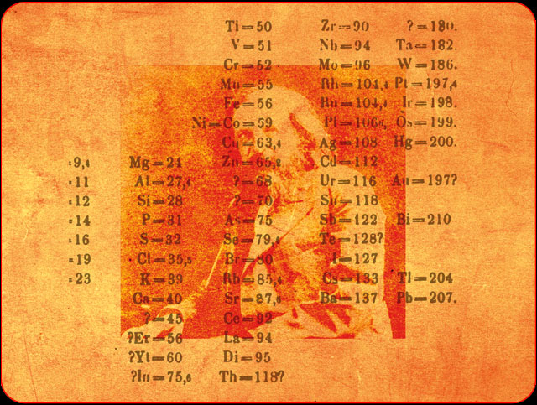

Slide 5
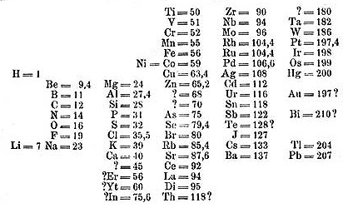

Slide 6
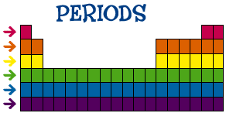
Periods
The horizontal row in the table

Slide 7
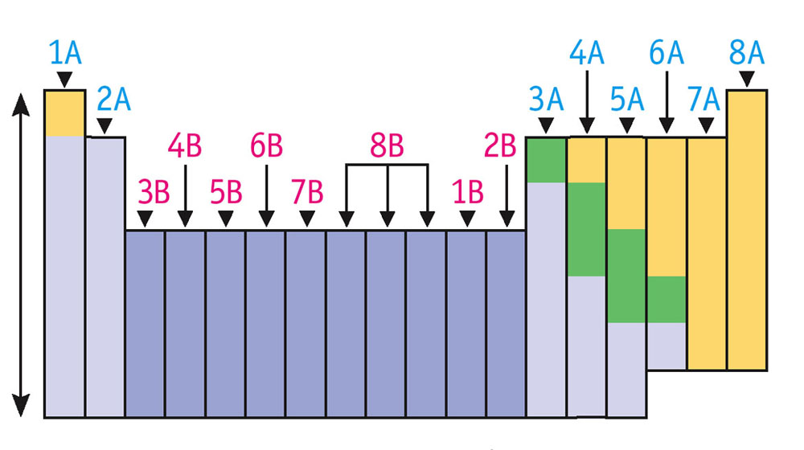
Groups
The vertical column of elements: they share some properties

Slide 8
The Atoms Family - Atomic Math Challenge
Atomic Number
Symbol
Name
Atomic Mass
protons
Atomic number equals the number of ____________ or ________________.
electrons
protons
Atomic mass equals the number of ______________ + _______________.
neutrons

Slide 11
Solids= Blue
Liquids=Green
Gases=Red

Slide 12
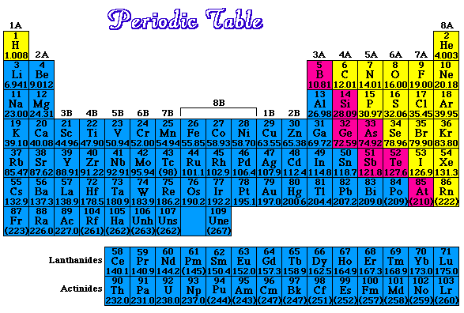
Metals=Blue
Nonmetals=Yellow
Metalloids=Pink

