Slide 1
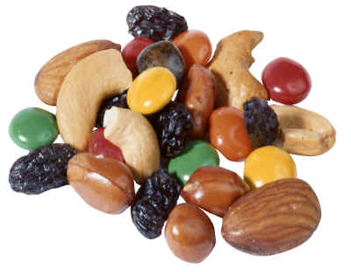
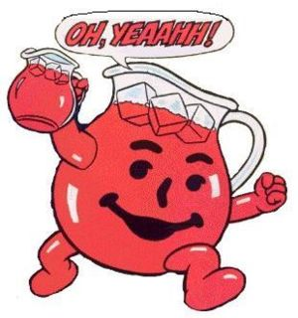
MIXTURES

Slide 2
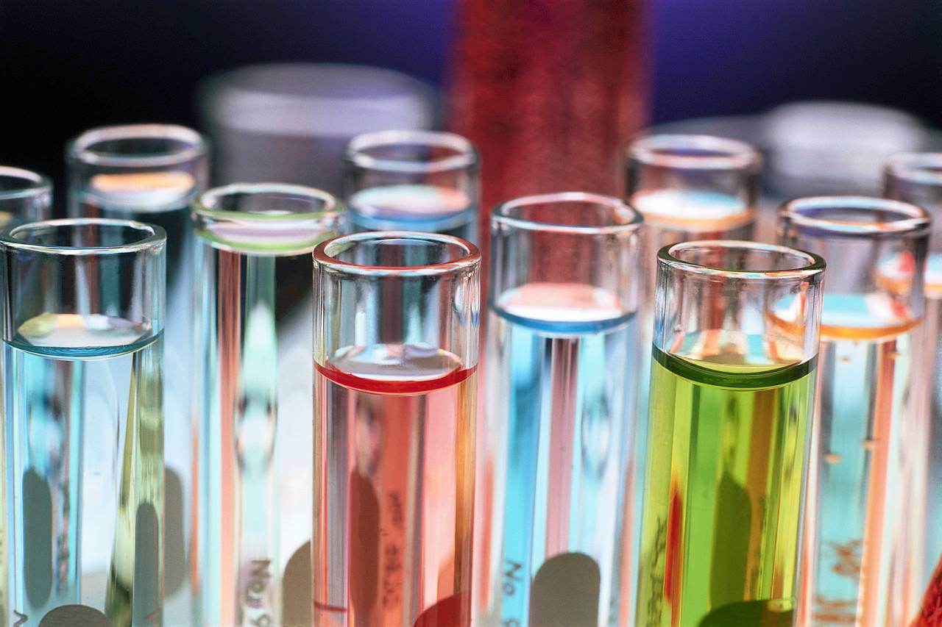
Review
What is the difference between a mixture and a compound?
A compound is formed chemically and a mixture is not

Slide 3
Review
What are the types of two mixtures?
Homogeneous and Heterogeneous

Slide 4
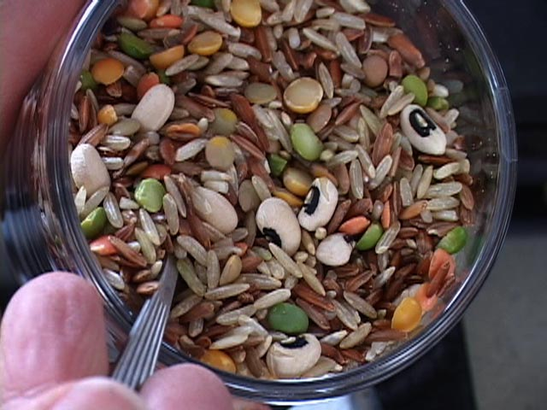
Heterogeneous or Homogeneous

Slide 5
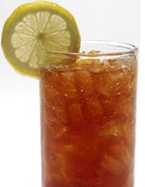
Heterogeneous or Homogeneous

Slide 6
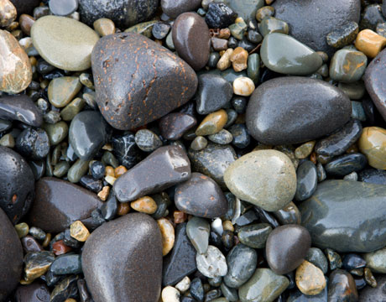
Heterogeneous or Homogeneous

Slide 7
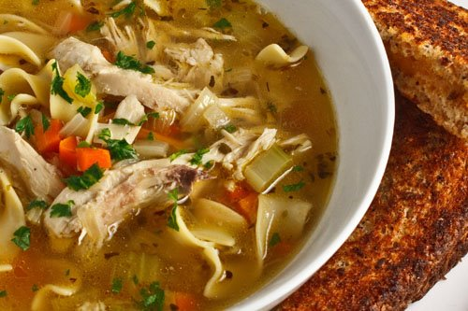
Heterogeneous or Homogeneous

Slide 8
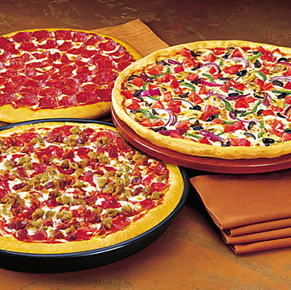
Heterogeneous or Homogeneous

Slide 9
Heterogeneous or Homogeneous

Slide 10
Heterogeneous or Homogeneous
Air?

Slide 11
Separating Mixtures
Since mixtures are not “CHEMICALLY” combined there must be some way to separate them right?
Can you think of some ways?

Slide 12
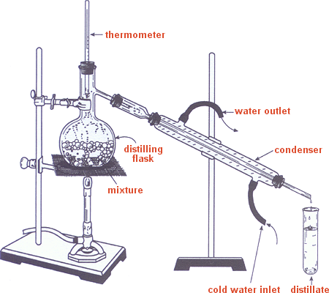
Common Separation Methods
Distillation- process that separates mixtures based on boiling them
Distilled water, salt-water

Slide 13
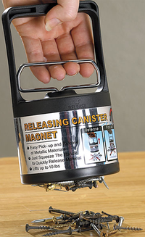
Common Separation Methods
Magnet- can be used to separate mixtures of metals

Slide 14
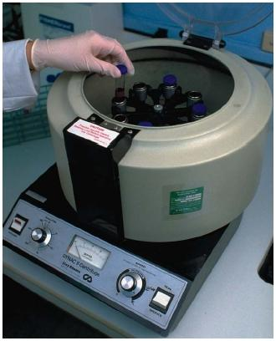
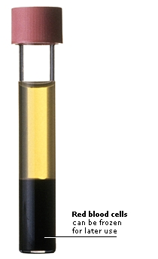
Common Separation Methods
Centrifuge- a machine that spins to separate the different mixtures

Slide 15
3 Special Mixtures
Solution- a homogeneous mixture that has 2 or more substances dispersed uniformly (another word for homogeneous solution)
Solute-the substance that is dissolved
Solvent- the substance that is doing the dissolving
Concentration-the amount of solute dissolved in a solvent

Slide 16
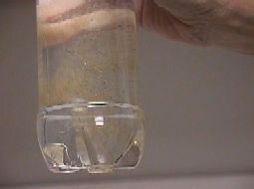
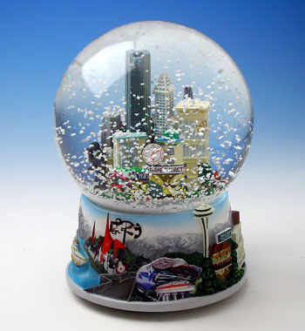
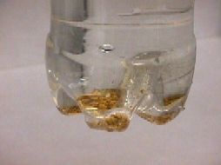
3 Special Mixtures
2. Suspension- a mixtures that the particles can be dispersed but are also large enough to settle

Slide 17
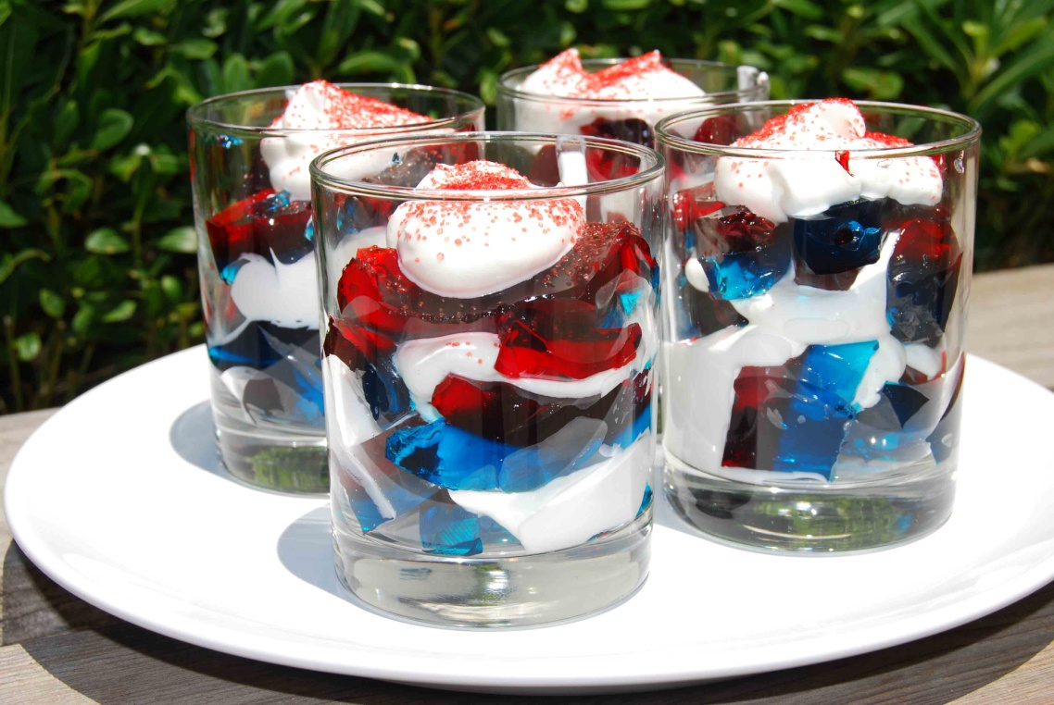
3 Special Mixtures
3. Colloid- particles are tiny and medium in size and are dispersed throughout a mixture

Slide 18
3 Special Mixtures
Solutions
Small
Particle
Size
Increases
Colloid
Medium
Large
Suspension

