Slide 1
What’s the “Matter”

Slide 2
What is Matter Really?
Anything that has mass and takes up space
So are these things matter?
Car?
You?
Air?
Love?

Slide 3
Mass vs Weight
Mass is the amount of “matter” in an object
Weight is the measure of gravitational pull on an object

Slide 4
Volume
Regular Shapes
Length x Width x Height
Irregular Shapes
Water displacement in Graduated Cylinders

Slide 5
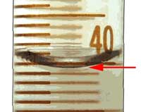
One Problem Though….
Meniscus
So measure it by
Looking at the bottom
Of the buldge

Slide 6
Measuring Liquid Volume
What is the volume of water in each cylinder?
Images created at http://www.standards.dfes.gov.uk/primaryframework/downloads/SWF/measuring_cylinder.swf
A
B
C
Pay attention to the scales for each cylinder.

Slide 7
Properties of Matter

Slide 8
Physical Properties
A characteristic that can be observed or measured without changing the matter’s identity

Slide 9
DO NOT WRITE
Examples of Physical Properties
States of matter (gas, liquid, solid)
Density
Malleability
Ductility
Magnetism
Thermal Conductivity
Solubility

Slide 10
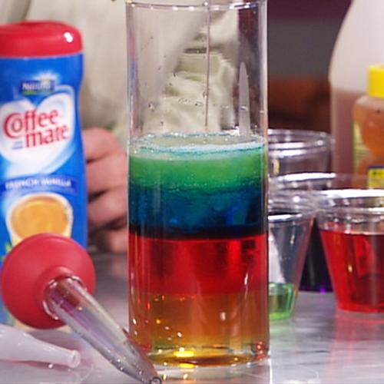
Density
The amount of matter in a given space or in a certain volume

Slide 11
Special Physical Properties
Melting point: the temperature at which a substance changes from a solid to a liquid at a given pressure
water = 0ºC
Boiling point: the temperature at which a substance changes from a liquid to a gas at a given pressure
water = 100ºC

Slide 12
Specific Heat
The quantity of heat used to raise one unit mass of material 1 K or 1degree Celsius in a constant environment

Slide 13
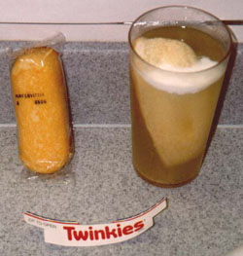
Solubility
How well a substance dissolves in to something else

Slide 14
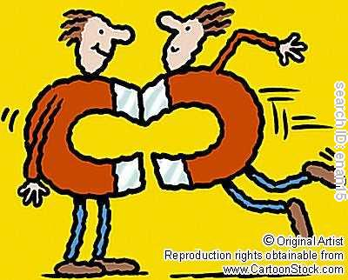
Magnetism
Force of attraction or repulsion between various substances, especially those made of iron and certain other metals; ultimately it is due to the motion of electric charges.

Slide 15
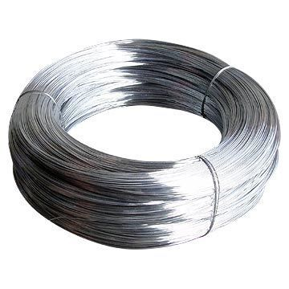
Ductility
The ability for something to be pulled into a thin wire

Slide 16
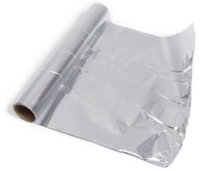
Malleability
The ability for something to be rolled or pounded into a thin sheet

Slide 17
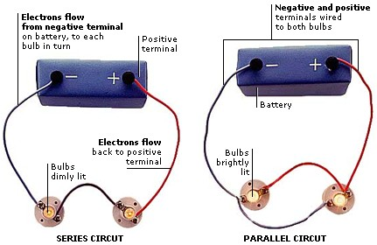
Electrical Conductivity
How freely charges move in a substance

