Slide 1
Grouping the Elements

Slide 2
Questions
What are the vertical columns in a periodic table called?
Groups
Each group, has elements in it that are similar and that’s why they are grouped together

Slide 3
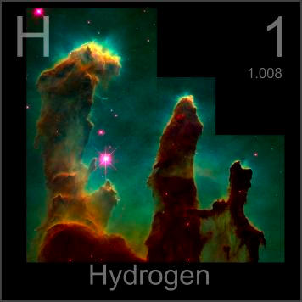
Hydrogen
Electrons in outer level: One
Reactivity: Reactive
Other Info: colorless, odorless at room temp

Slide 4
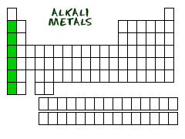
Group 1: Alkali Metals
Group contains: metals
Electrons in outer level: One
Reactivity: Very Reactive
Other Info: soft, silver color, shiny
Elements: Lithium, Sodium, Potassium

Slide 5
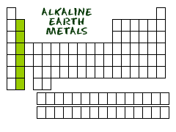
Group 2: Alkaline-Earth Metals
Group contains: metals
Electrons in outer level: Two
Reactivity: Very Reactive: less than alkali
Other Info: silver, less reactive
Elements: Beryllium, Calcium, Magnesium

Slide 6
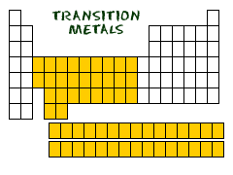
Group 3-12: Transition Metals
Group contains: metals
Electrons in outer level: One or Two
Reactivity: Reactive: less than alkaline- earth
Other Info: shiny, conductors
Elements: Iron, Mercury, Tungsten

Slide 7
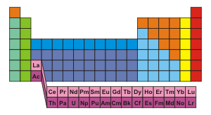
Special Transitions
Lanthanides:
Top row, shiny, reactive
Used a lot to make steel
Actinides:
Bottom row
Very Reactive and unstable

Slide 8
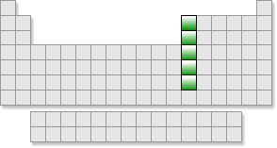
Group 13: Boron Group
Group contains: 1 metal & 4 metals
Electrons in outer level: Three
Reactivity: Reactive
Other Info: Solid at room temp
Elements: Boron, Aluminum, Gallium

Slide 9
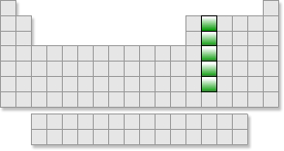
Group 14: Carbon Group
Group contains: 1 nonmetal, 2 metalloids, 2 metals
Electrons in outer level: Four
Reactivity: Varies
Other Info: Solid at room temp
Elements: Carbon, Silicon, Tin

Slide 10
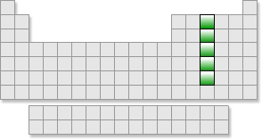
Group 15: Nitrogen Group
Group contains: 2 nonmetals, 2 metalloids, 1 metal
Electrons in outer level: 5
Reactivity: Varies
Other Info: Solid at room temp (except nitrogen)
Elements: Nitrogen, Phosphorus, Arsenic

Slide 11
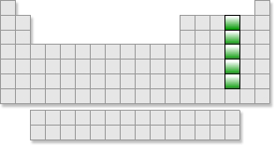
Group 16: Oxygen Group
Group contains: 3 nonmetals, 1 metalloid, 1 metal
Electrons in outer level: Six
Reactivity: Reactive
Other Info: Solid at room temp except oxygen
Elements: Oxygen, Sulfur

Slide 12
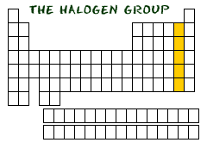
Group 17: Halogen Group
Group contains: nonmetals
Electrons in outer level: Seven
Reactivity: Very Reactive
Other Info: Poor conductors and violent
Elements: Fluorine, Chlorine, Bromine

Slide 13
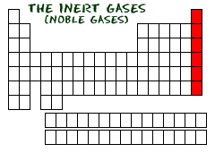
Group 18: Noble Gases
Group contains: nonmetal
Electrons in outer level: Eight except Helium
Reactivity: UnReactive
Other Info: colorless, odorless gases
Elements: Neon, Argon, Krypton

