Slide 1
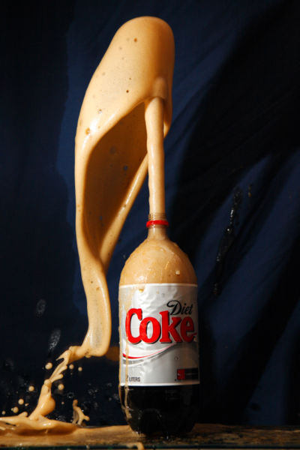
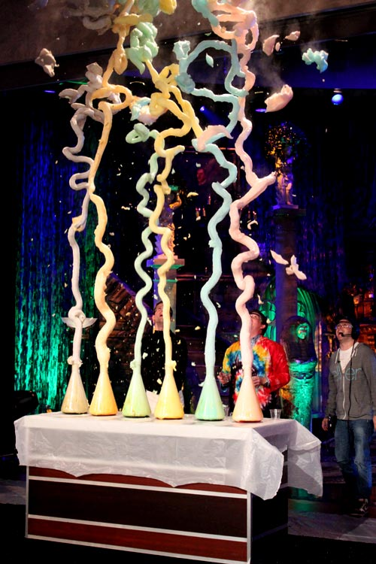
Chemical
Reactions

Slide 2
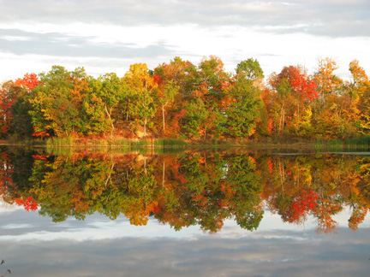
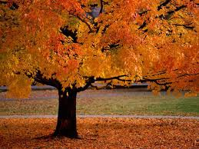
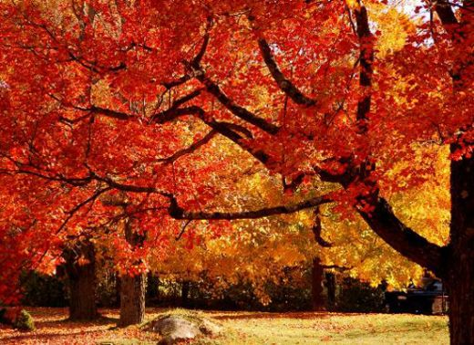
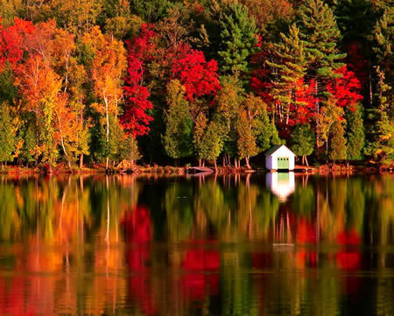
Think about this…..
Each fall, a beautiful change takes place when leaves turn colors. You see bright oranges and yellows that had been hidden by green all summer. What causes this change?

Slide 3
Chemical Reaction
A process in which one or more substances change to produce one or more different substances
Signs of Chemical Reaction
Gas formation
Solid Formation (Precipitate=a solid forming during a reaction
Energy Change ( Light or Thermal, ie Fire)
Color Change (Bleach on Jeans)

Slide 4
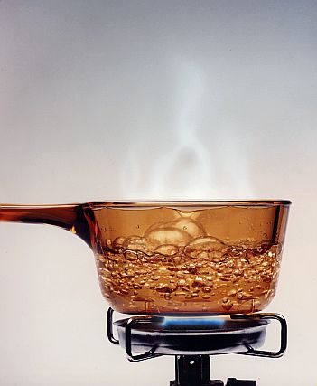
But not all the time
When water boils it gives off Thermal energy
But that is not a Chemical Reaction
Just be careful……….

Slide 5
Breaking and Making Bonds
Two Diatomic Molecules
H₂ and Cl₂
+
H₂
Cl₂
Hydrogen
Chloride

Slide 6
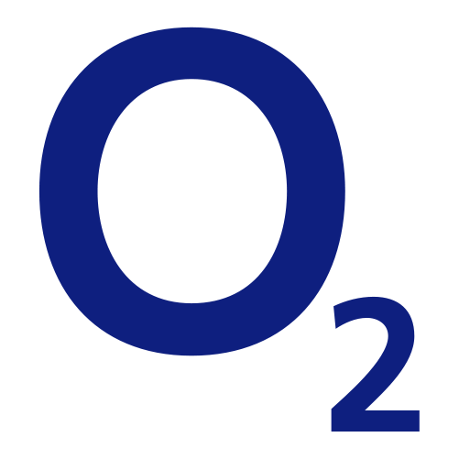
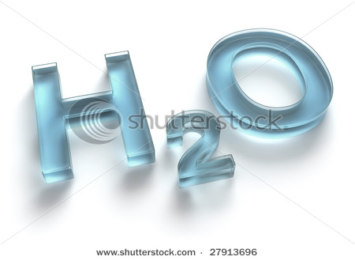
Chemical Formulas
A combination of chemical symbols and numbers to represent a substance

Slide 7
Prefixes to Remember
Prefixes Used in Chemical Names
Mono- 1 | Hexa- 6
Di- 2 | Hepta- 7
Tri- 3 | Octa- 8
Tetra- 4 | Nona- 9
Penta- 5 | Deca- 10

Slide 8
Example
Carbon Dioxide Carbon Monoxide
CO₂ CO

Slide 9
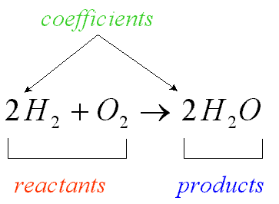
Chemical Equations
Yield Sign

Slide 10
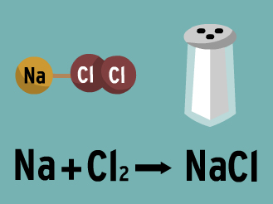

Slide 12
Law of Conservation of Mass
A law that states that mass cannot be created or destroyed
That means the total mass of the reactants equals that of the mass of the products

Slide 13
How to Balance Equations
Step 1: Count the Atoms on each side
H₂ + O₂ H₂O
H= H=
0= 0=

Slide 14
How to Balance Equations
Step 2: Balance one element at a time
H₂ + O₂ H₂O
H=2 H=2
0=2 0=1

Slide 15
How to Balance Equations
Step 3: Balance the next element now
H₂ + O₂ 2H₂O
H=2 H=2 4
0=2 0=1 2

Slide 16
Example
Na + Cl₂ NaCl
Mg + N₂ Mg₃N₂

Slide 17
Example (A harder one)
C₃H₈ + O₂ ---> H₂O + CO₂

Slide 18
Types of Chemical Reactions

Slide 19
Types of Chemical Reactions
Synthesis Reaction- 2 or more substances combine to form a new compound
Example:
2Na + Cl₂ ----> 2 NaCl

Slide 20
Types of Chemical Reaction
2. Decomposition Reaction- A compound breaks down to form 2 or more simpler substances
Example
H₂CO₃ -------> H₂O + CO₂
Reverse of Synthesis

Slide 21
Types of Chemical Reactions
3. Single-Displacement Reaction- one element takes the place of another element in a compound
Example
Zn + 2HCl -----> ZnCl₂ + H₂

Slide 22
Types of Chemical Reactions
4. Double-Displacement Reaction- a reaction when two elements switch places in a compound
Example
NaCl + AgF -------> NaF +AgCl

Slide 23
Energy with Reactions
When a reaction causes energy to be released it is called exothermic reaction
Exo means exit
Types of Exothermic Reactions
Light Energy (Glow stick)
Electrical Energy (Flashlight)
Both (Fire)

Slide 24
Energy with Reactions
When a reaction needs energy it is called endothermic reaction
Endo means go in (Think Endo means Enter0

Slide 25
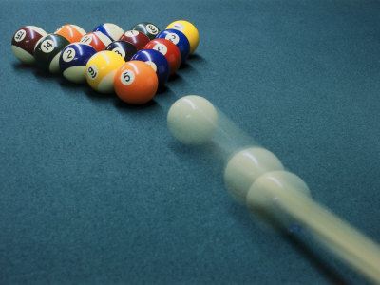
Law of Conservation of Energy
Energy cannot be created or destroyed but will be changed from one to another

Slide 26
Definitions
Activation energy- smallest amount of energy to start a reaction
Inhibitor- a substance that slows down a reaction
Catalyst- a substance that speeds up a reaction

