Slide 1
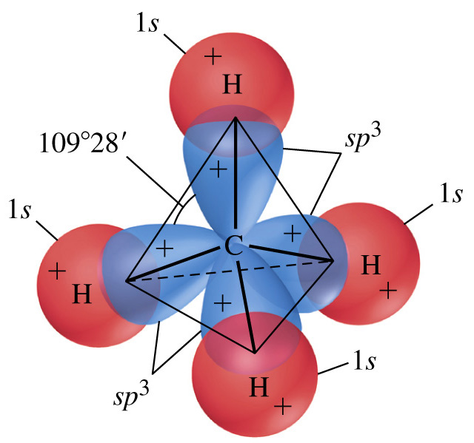
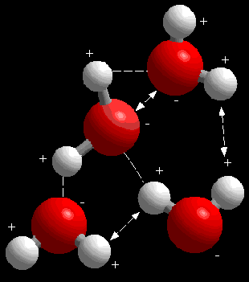
Chemical Bonding with Elements

Slide 2
Electron Configuration
8e⁻
2 e⁻
18e⁻
32e⁻

Slide 3
Valence Electrons
VERY VERY SIMPLE……
It is just the electrons on the outer shell of an atom

Slide 4
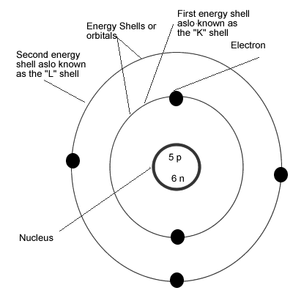
How Many Valence Electrons?

Slide 5
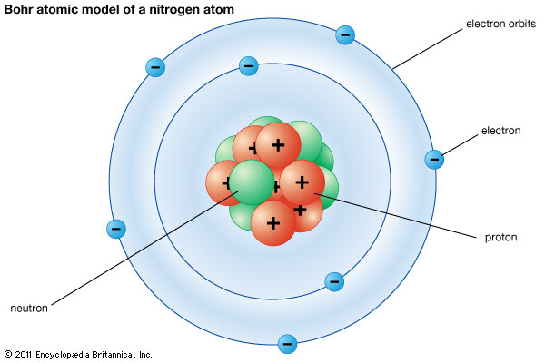
How Many Valence Electrons?

Slide 6
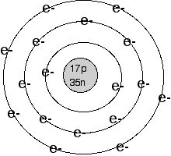
How Many Valence Electrons?

Slide 7
Example
Carbon= 6 protons, 6 electrons, 6 neutrons

Slide 8
Valence Electrons based off of Groups
Group 1: 1 valence electron
Group 2: 2 valence electrons
Group 3-12: 1 or 2 valence electrons
Group 13: 3 valence electrons
Group 14: 4 valence electrons
Group 15: 5 valence electrons
Group 16: 6 valence electrons
Group 17: 7 valence electrons
Group 18: 8 valence electrons

Slide 9
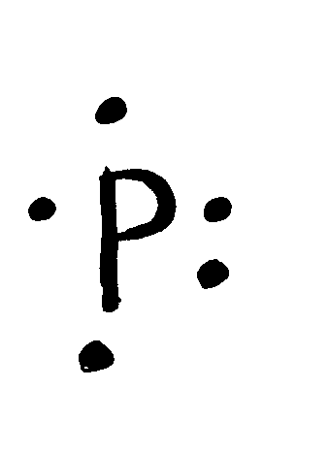
Before we start let’s look at something
Electron-Dot Diagrams a.k.a Lewis Structure
This is another way to write Electrons but it only shows the number of Valence electrons
They are together in four pairs

Slide 10
In Order for an Atom to be Happy
It needs
A complete outer shell
That’s why the noble gases are what we call “Stable”

Slide 11
Let’s try a few together
Neon= 8 valence electrons
Lithium=1 valence electrons
Calcium=2 valence electrons
Oxygen= 6 valence electrons

Slide 12
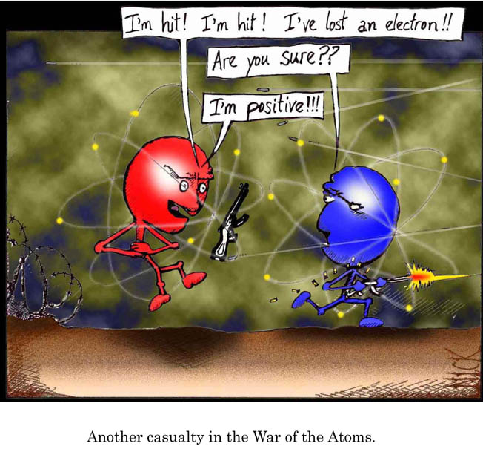
What is Chemical Bonding???
It is the joining of two or more atoms to form a NEW substance

Slide 13
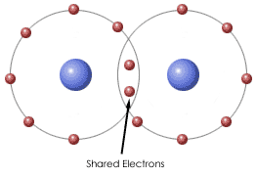
Chemical Bonding
When Elements bond they bond over ELECTRONS.

Slide 14
3 Types of Bonding
Ionic
Covalent
Metallic

Slide 15
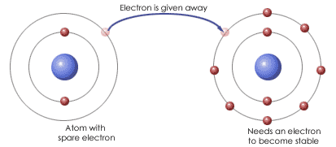
Ionic Bonding
It is a bond that is formed when ELECTRONS ARE TRANSFERRED from 1 atom to another
The Result is either them being positive or negative

Slide 16
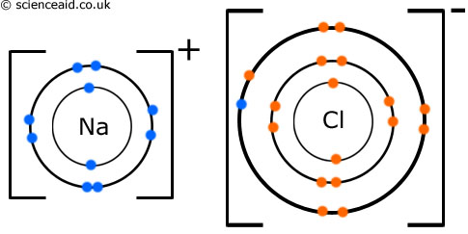

Slide 17
The Result of Ionic Bonding
You have a particle that is called an ION=a charged particle that forms when an atom gains or loses electrons
Cation=positive ion
Anion= negative ion

Slide 18
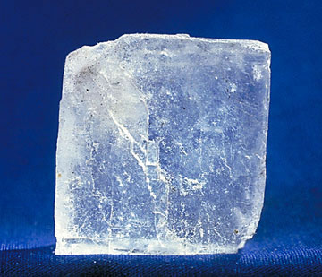
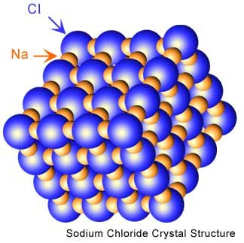
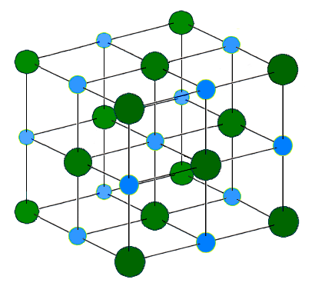
Ionic Compounds
One neat thing that ionic compounds form is something called CRYSTAL LATTICE
It is the regular pattern in which a crystal is arranged

Slide 19
That’s the end of IONIC Bonding
On to the next one…………………

Slide 20
Covalent Bonding
It forms when atoms share one or more PAIRS of electrons

Slide 21
Lets look at the water molecule

Slide 22
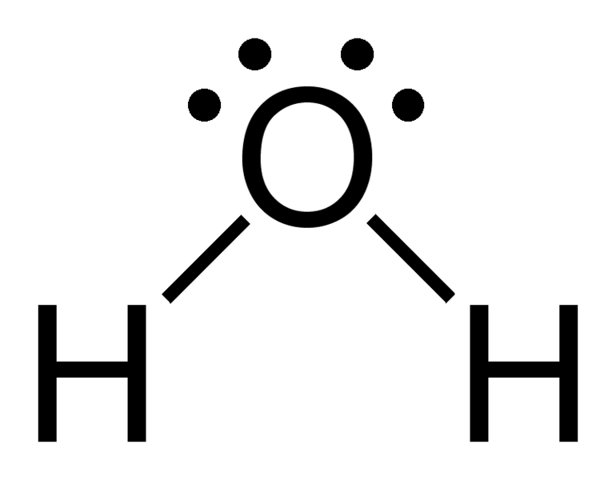
If we bond them by Covalent Bonding

Slide 23
Diatomic Molecules
Two or more of the same elements bonded together

Slide 24
List of 7 Diatomic Molecules
Hydrogen (H₂)
Nitrogen (N₂)
Oxygen (O₂)
Fluorine (F₂)
Chlorine (Cl₂)
Iodine (I₂)
Bromine (Br₂)

Slide 25
And last of all………..

Slide 26
Metallic Bonding
A bond formed by the attraction between positively charged metal ions and the electrons around them

